Slide 1
Potential outcomes and propensity score methods for hospital performance comparisons
Patrick Graham,
University of Otago, Christchurch

Slide 2
Acknowledgements
Research team includes:
Phil Hider, Zhaojing Gong
– University of Otago, Christchurch
Jackie Cumming, Antony Raymont,
- Health Services Research Centre , Victoria
University of Wellington
Mary Finlayson, Gregor Coster,
- University of Auckland
Funded by HRC

Slide 3
Context
Study of variation in NZ public hospital outcomes
Data Source: NMDS – Public Hospital Discharge Database, linked to mortality data by NZHIS.
Outcomes: Several outcomes developed by AHRQ ; 10+ in first study, 20-30 in second study.
Multiple analysts involved – range of statistical experience
Ideally, would like to jointly model performance on multiple outcomes.

Slide 4
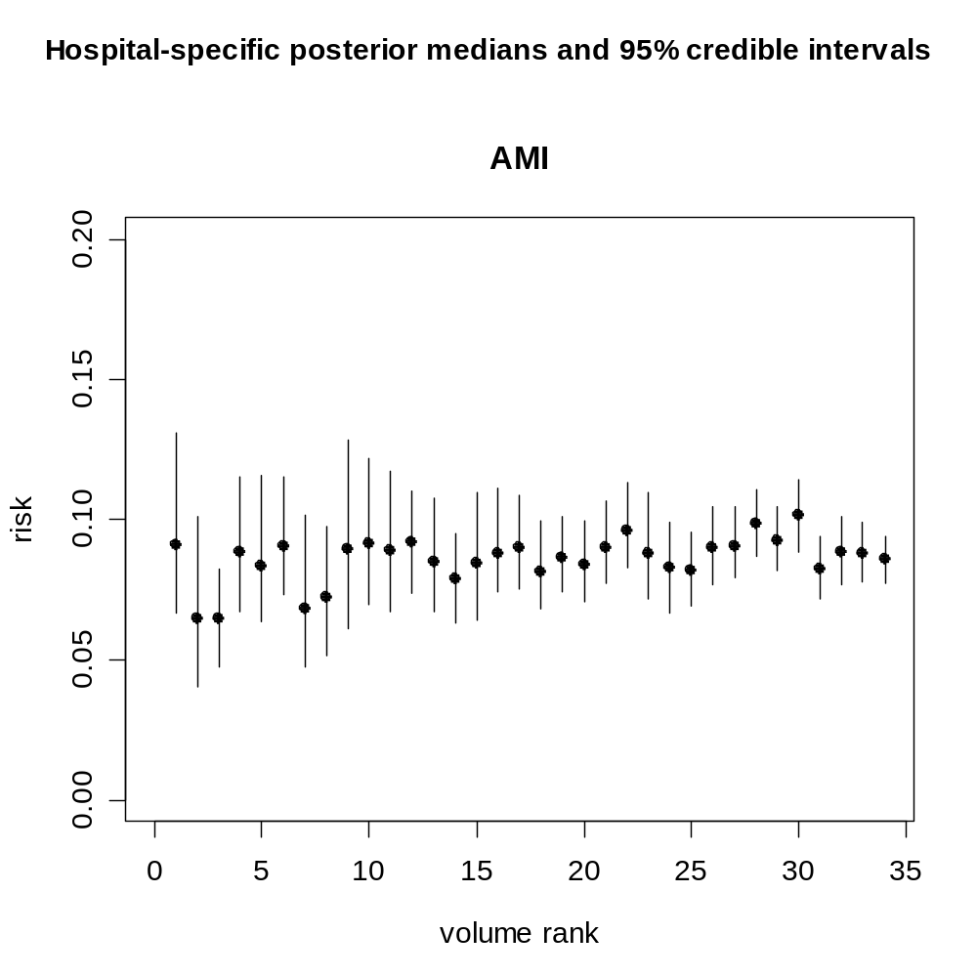

Slide 5
Statistical Contributions to Hospital Performance Comparisons
“Institutional Performance” , “Provider Profiling”
Spiegelhalter (e.g. Goldstein & Spiegelhalter, JRSSA, 1996)
Normand (e.g. Normand et al JASA, 1997)
Gatsonis (e.g. Daniels & Gatsonis, JASA 1999)
Howley & Gibberd (e.g Howley & Gibberd, 2003)

Slide 6
Role of Bayesian Methods
Hierarchical Bayes methods prominent -
- shrinkage, pooling
Good use made of posterior distributions, e.g.
Pr(risk for hospital h > 1.5 x median risk | data) (Normand, 1997)
Pr(risk for hospital h in upper quartile of risks | data)

Slide 7
Hospital performance and causal inference
Adequate control for case-mix variation is critical to valid comparisons of hospital performance.
In discussion of Goldstein & Spiegelhalter (1996) Draper comments :
“Statistical adjustment is causal inference in disguise.”
Here I remove the disguise by locating hospital performance comparisons within the framework of Potential Outcomes models.

Slide 8
Potential Outcomes Framework
Neyman (1923), Rubin (1978).
Key idea is that, in place of a single outcome variable, we imagine a vector of potential outcomes corresponding to the possible exposure levels.
Causal effects can then be defined in terms of contrasts between potential outcomes.
Counterfactual because only observe one response – the fundamental inferential problem

Slide 9

Application of potential outcomes to hospital performance comparisons - notation
Y(a) – outcome if treated at hospital a
X - vector of case-mix variables
H - hospital actually treated at
Y^{obs} – observable response:
θ - generic notation for vector of all parameters involved in this problem
No “unexposed” group or reference exposure category.

Slide 10

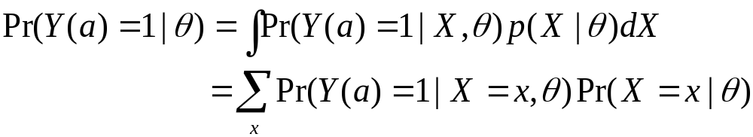
Application of Potential Outcomes to
hospital performance – key ideas
For binary outcomes can focus on the marginal risks
and compare these marginal risks over a
Note:
for discrete X.

Slide 11
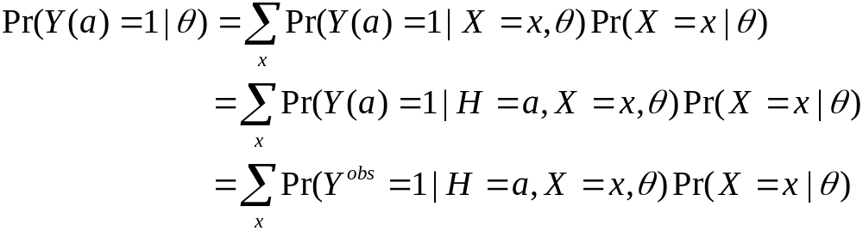
Ignorability
H is weakly ignorable if
and this implies
The latter expression is the traditional epidemiological
population standardised risk – involves only observables

Slide 12
More on ignorability
Under weak ignorability the marginal risks are equivalent to conventional population standardised risks which are defined in terms of observables.
Consequently weak ignorability implies that inference for the marginal risks can follow a fairly standard track.
More detailed model specification reveals that weak ignorability is equivalent to an identifiability constraint in the likelihood function. In the absence of weak ignorability the likelihood will not be fully identified.

Slide 13
But what is weak ignorability?
Given X, learning H does not tell us anything extra
about a patient’s risk status, and hence does not affect assessments of risk if treated at any of the study hospitals.

Slide 14
Two examples of non-ignorability
Hospitals select low risk patients and good measures of risk are not included in X.
High risk patients select particular hospitals and good measures of risk are not included in X.

Slide 15
Practicalities
If weak ignorability holds, we need only consider
models for the observable outcomes.
For example, a hierarchical logistic model with hospital specific parameters linked by a prior model which depends on hospital characteristics.

Slide 16
Practicalities (2)
Many case-mix factors (X) to control; age, sex, ethnicity, deprivation, 30 comorbidities, 1 – 3 severity indicators.
Tens of thousands of patients.
Full Bayesian model-fitting via MCMC can be impractical for large models and datasets.
With large number of case-mix factors overlap in covariate distributions between hospitals may be insufficient for credible standard statistical adjustment.

Slide 17
Propensity score methods (1)
Introduced for binary exposures by Rosenbaum & Rubin (1983) – probability of exposure given covariates.
Imbens (2000) clarified definition and role in causal inference for multiple category exposures. In this case the generalised propensity scores are
Easy adaptation to bivariate exposure, e.g for
hospital (H) and condition (C)

Slide 18
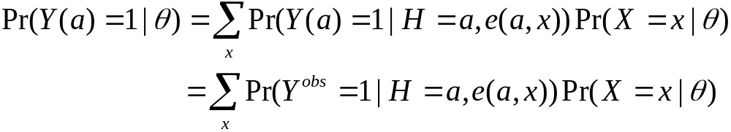
Propensity score methods (2)
If H is weakly ignorable given X, then H is weakly
ignorable given the generalised propensity score.
This implies
and consequently

Slide 19

Propensity score methods (3)
The modelling task is now to model:
At first glance this appears to be well-suited to a
hierarchical model structure –e.g. a set of hospital
specific logistic regressions, linked by a model for the
hospital-specific parameters.
Notes:
For each H=a, model logistic regression of observable outcomes against propensity scores

Slide 20
Propensity score methods (4)
Modelling - some reasons to
hesitate:
Different regressor in each hospital, e(1,X) for H=1; e(2,X) for H=2 etc. This potentially complicates construction of a prior model.
Little a priori knowledge concerning relationship of propensity scores to risk.
Need flexible regressions. Yet standardisation implies that hospital specific models may need to be applied to prediction of risk for propensity score values not represented among a hospital’s case-mix.

Slide 21
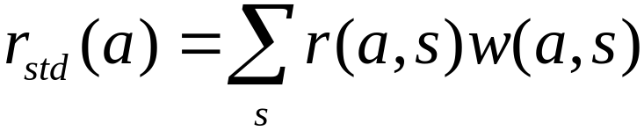

Propensity score methods (5): Stratification on propensity scores followed by smoothing
Huang et al (2005).
For a =1,…,K construct separate stratifications of study population by e(a,X).
Compute
(iii) Smooth the data summaries
Where:
w(a,s) is the proportion of the study population in stratum s for e(a,X);
r(a,s) is the observed risk among patients treated in hospital a, who are in stratum s of e(a,X).

Slide 22
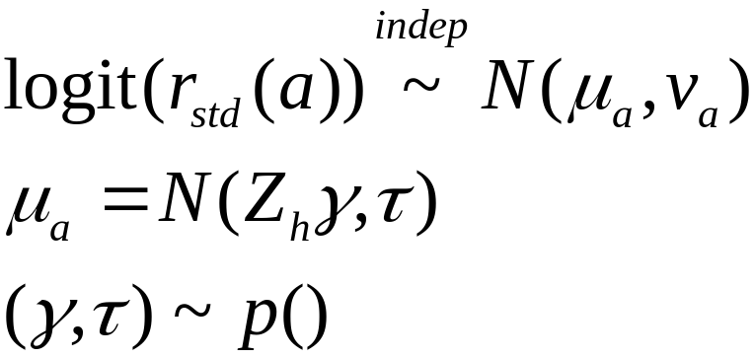
Propensity score methods (6) : Modelling
standardised risks
Given stratification based estimates of standardised
risks we can model these data summaries as follows
Inference is now based on the joint posterior for the μ_{a}
First stage variances are assumed known and set to the
delta method estimate.
A standard hierarchical normal model
e.g (Lindley & Smith, 1972)

Slide 23
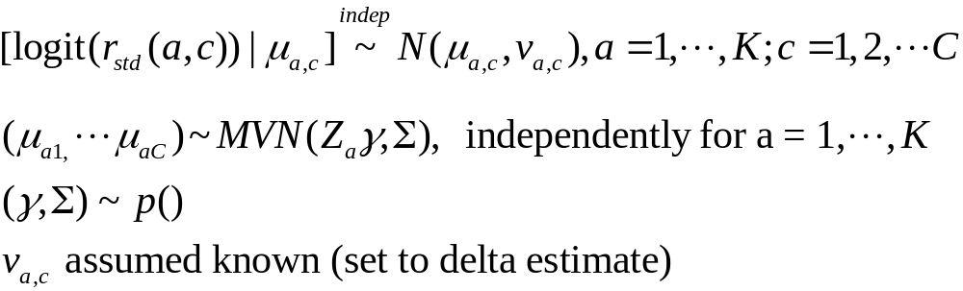

Joint modelling of standardised risks for multiple
conditions.
Compute non-parametric estimates of standardised
risks for each condition and hospital, r_{std}(a,c)
A hierarchical multivariate normal model.
Inference based on joint posterior for
Notes:
First stage variances assumed known and set to delta method estimate

Slide 24

Fitting the hierarchical multivariate normal model.
Could use Gibbs sampler, but method of
Everson & Morris, (2000) is much faster.
E&M use an efficient rejection sampler to generate independent samples from
Remaining parameters can then be generated from standard Bayesian normal theory using,
E&M approach now available in the R package tlnise
(assumes uniform prior for regression hyper-parameter; uniform, uniform shrinkage or Jeffreys' prior for variance hyper-parameter)

Slide 25
Application
34 NZ public hospitals
3 conditions AMI, stroke, pneumonia
~20,000 AMI patients;
~ 10,000 stroke patients;
~ 30,000 pneumonia patients.
Controlling for age, sex, ethnicity, deprivation level, 30 comorbidities, 1 to 3 severity indicators.
Propensity scores estimated using multinomial logistic regression.

Slide 26
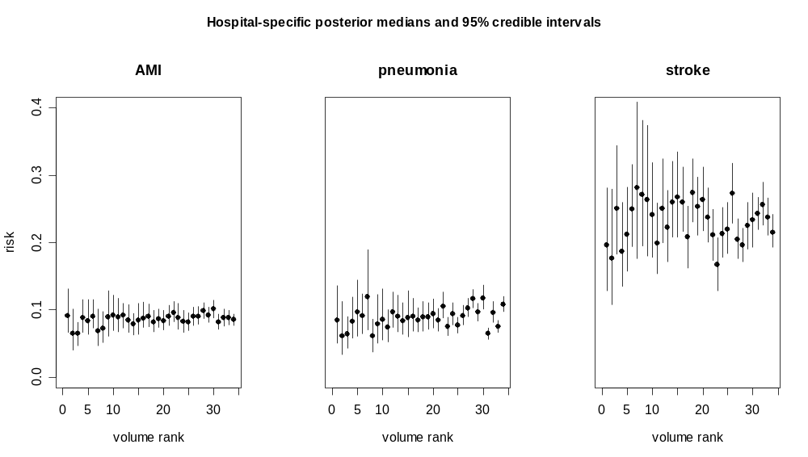

Slide 27
Contrasts between percentiles of the between hospital distribution for 30-day AMI mortality
Contrast | Crude CMA Estimate | HB post. median 95% CI
Rel. Risk
Max v Min | 4.47 | 1.96 | 1.48 - 3.14
90% v 10% | 1.81 | 1.40 | 1.22 – 1.69
75% v 25% | 1.22 | 1.18 | 1.1 – 1.29
Risk Diff.(%)
Max v Min | 10.06 | 5.43 | 3.35 - 8.79
90% v 10% | 5.37 | 2.86 | 1.76 – 4.29
75% v 25% | 1.77 | 1.43 | 0.8 - 2.17
Preliminary results – not for quotation

Slide 28
Contrasts between percentiles of the between hospital distribution for 30-day pneumonia mortality
Contrast | Crude CMA Estimate | HB post. median 95% CI
Rel. Risk
Max v Min | 7.28 | 2.68 | 1.93 – 4.36
90% v 10% | 2.06 | 1.69 | 1.46 – 2.02
75% v 25% | 1.41 | 1.32 | 1.20 -1.47
Risk Diff.(%)
Max v Min | 12.72 | 8.27 | 5.60 – 13.91
90% v 10% | 6.37 | 4.57 | 3.39- 6.13
75% v 25% | 3.07 | 2.45 | 1.60 – 3.39
Preliminary results – not for quotation

Slide 29
Contrasts between percentiles of the between hospital distribution for 30-day acute stroke mortality
Contrast | Crude CMA Estimate | HB post. median 95% CI
Rel. Risk
Max v Min | 3.69 | 2.18 | 1.63 – 3.39
90% v 10% | 1.68 | 1.51 | 1.32 – 1.81
75% v 25% | 1.32 | 1.25 | 1.15 -1.39
Risk Diff.(%)
Max v Min | 27.33 | 17.39 | 11.18 – 27.88
90% v 10% | 12.53 | 9.56 | 6.37 – 13.43
75% v 25% | 6.54 | 5.19 | 3.25 – 7.88
Preliminary results – not for quotation

Slide 30
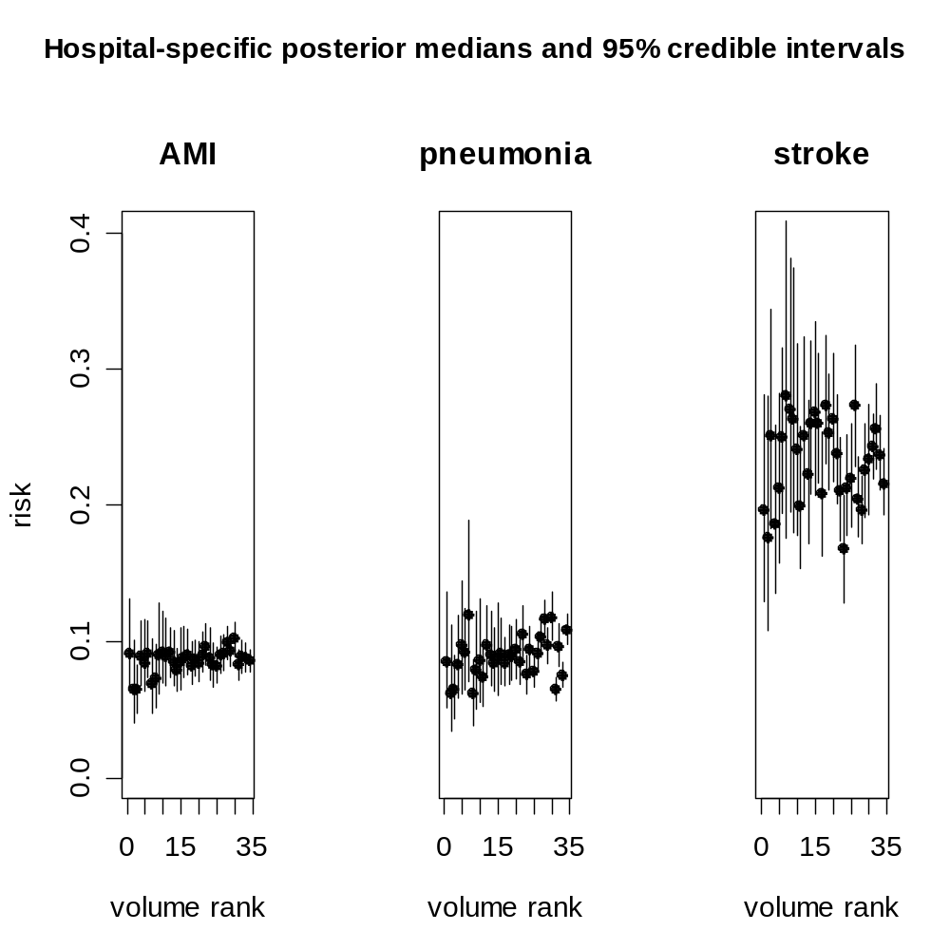

Slide 31
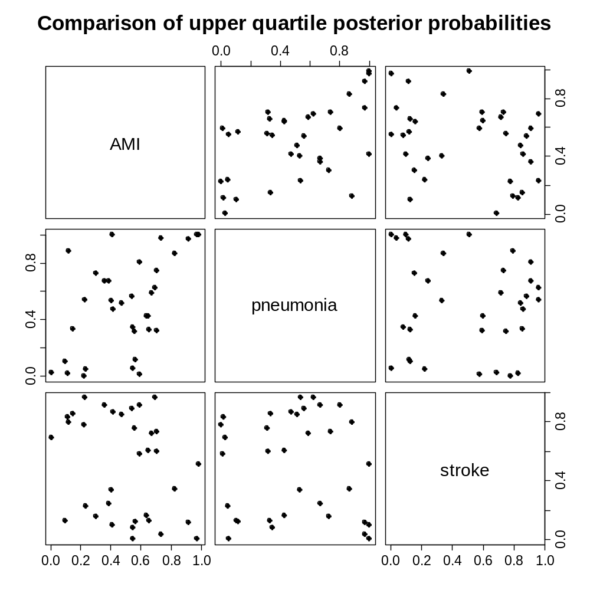

Slide 32
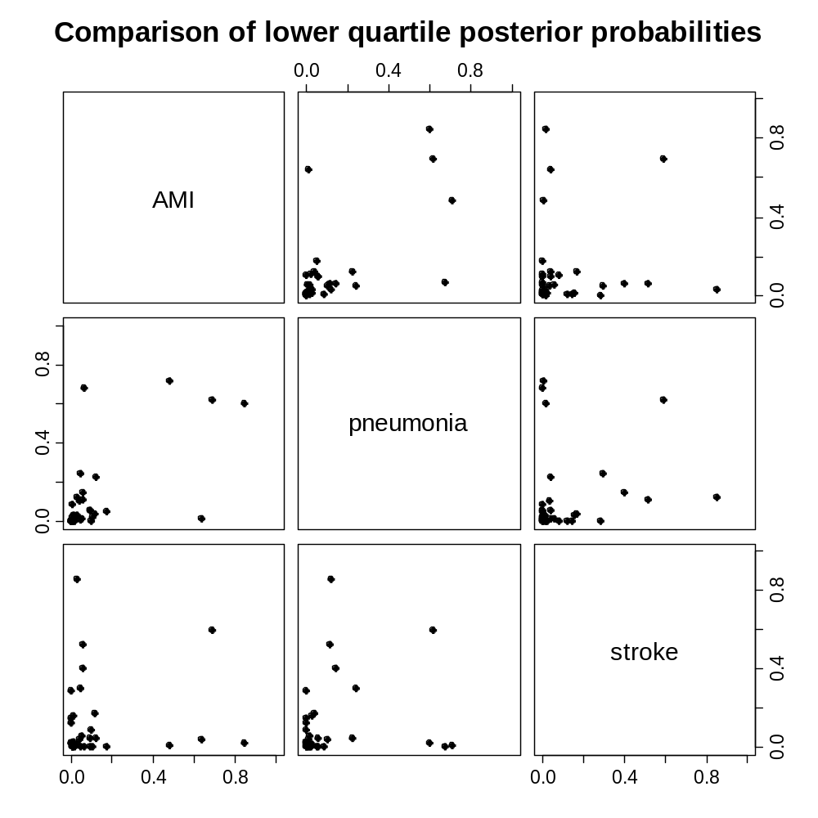

Slide 33
Summary
Imperfect methodology
- likelihood approximation
- stratification
Nevertheless, the approach focusses attention on the key issue of case mix adjustment.
Computing time is minutes rather than many, many hours for full Bayesian modelling.

Slide 34
Discussion
Propensity score theory is worked out assuming known propensity scores.
In practice propensity scores are estimated, but uncertainty concerning propensity scores is not reflected in analysis.
Recent work by McCandless et al (2009a, 2009b) allows for uncertain propensity scores but results are unconvincing as to merits of this approach, even though it appears Bayesianly correct.
When exploring sensitivity to unmeasured confounders the propensity score is inevitably uncertain.
An interesting puzzle which needs more work.

Slide 35
Discussion cont’d
What do we gain from potential outcomes framework?
- focus on ignorability assumption and hence
adequacy of case-mix adjustment .
- propensity score methodology
Nevertheless, could arrive at the analysis methodology, – nonparametric standardisation followed by smoothing, by some other route.

